Slide 1
K&B Category Strategy

Slide 2
Mission Statement
Create Excitement In A Mature,
Often Overlooked Category To Win
Mind-Share With The Sales Force
And Differentiate Our Offering
Through New Product Development, Product Knowledge And New Services

Slide 3
Executive Summary
King Of Water Heating ($370 Million LT)
Best Brand
Market Competitive Price
In-Stock Product
Regional Product Nuances
Field Level Support
Commercial Install
Residential Install
Depth & Breath of Water Heater Repair
Season’s Toilets #1 Brand Of Professional Property Managers ($8 Million LT)
Complete Assortment
Unique Designs To Fit Needs Of Our Customers
Complete Offering of Repair Parts
Specification Into Key Industries
Enhance Profitability of Disposer Category ($1.5 Million LT)
Import Options
Up Sell to ½ HP Through Marketing
Expand Commercial SKUs via VSKU Program
Pack Size Change
Bundles With Sinks
Drive Higher-End Disposers Into Non-MFA
King Of Drain Cleaning ($500,000 LT)
Multiple Brand Choices
Accessories Are Razor Blades
VSKU Programs
Educate On DIY
Destination For DIY Bathroom Upgrade (Too Blue Ocean To Model)
Complete Offering From OPP to Premium
Field Level Support
Build PB Brand Focused On Ease-of-Install
Marketing To Convey DIY Message
Install Services

Slide 4
Long-Term Initiatives
Multiple Installation Opportunities (Water Heaters (in-progress), Toilets (specific MSA), Bathroom Fixtures (not started)
Target National Account Customers That “Build New” For Season’s Toilets (i.e. specify Seasons into MFA)
Partner With Other Merchant Teams (Faucets & Fabrication) To Build Season’s Complete Bathroom Program (Toilets, Sinks, Vanities, Faucets, Showerheads, Bathtubs, Surrounds, Shower Doors, etc) To Help MFA Customers Standardize
Specification Team To Get Season’s Products Spec-ed Into HOSP
Rental Program For Drain Cleaning
“Subscribe & Save” Program On Toilet & Tank Repair, Water Filtration

Slide 5
Process Improvements
Leverage Internal Partners
Allow MerchOps Team To Execute As Much As Possible
Invest In Sales Support Partner To Eliminate FAR Noise
Vendor Product Training And Bi-Weekly Meetings Create Empowerment For Special Orders
Partnered With Billy Johnson’s Team To Deep-Dive On Warranty Programs To Create Empowerment For His Team
Build Scale Into Everyday Processes
K&B Promo Price File Improves Speed-To-Market On Quotes & Creates Consistency
K&B Promo Price File Improves SKU Selection Process For Marketing Pieces
To-Do Tracker Improves Time Management & Task Prioritization
Gantt Chart To Improve Execution of Strategic Initiatives
SKU Setup Converted to Year Around Process
Divide & Conquer Merch Plumbing Emails

Slide 6
Back-to-Basics
Catalog
Web
Sales Force
Enhance Assortment For Shop Ability
Good/Better/Best Progressions
Adding More Solutions Selling SKUs
Emerging Vertical Focus
Buying Guides To Drive Behavior
Toilets
Public Washroom
Stop Valve/Supply
Drain Cleaning
Water Filtration
Water Heaters
Catalog Ad Pages To Showcase Strategic Vendor Partners
Foremost Shower Doors
Niagara Toilets
American Standard Toilets
Fluidmaster T&T Repair
Korky T&T Repair
Sharkbite Push-to-Connect
General Wire
Bradford White
Data Scorecard
100% Perfect Short Descriptions
0 Missing Images
0.3% Parts with Videos
16.9% Parts with PDF
Filterable Attributes In Process
VSKU Program
10 Vendor Programs With Active Sales
$88,000 In GSAR @ 27 points
3 Vendor Programs In Process
Parts Warehouse
2 Vendor Programs
Landing Pages
Water Heaters
PB Toilets w/XL Footprint
Additional Images
5 Images / SKU
eProcurement Sites
How To Leverage Marketing Spots To Drive Category Sales
Make Product Knowledge A Year Around 24/7 Process, Not A Won & Done At Sales Tradeshow
K&B Quick Notes
Distributed To Sales Leadership
Posted on Sales Link
Presented On Market Walks
Monthly Conference Calls
Inside Sales eCoupon Program
Program Initiated in 2014
10 Unique Source Codes For Each Product Category
K&B On The Road
Mini-Trade Shows
Setting up Chicago
Leverage Maintenance Mania
How to Leverage Local MM Events to Drive Category Sales

Slide 7
Line/Desk Review (Major Categories)
Category | 2013 | 2014 | 2015 | 2016
Water Heaters ($45 MM Category) | Bradford Conversion | Drive Program Develop Install Fix Logistics | Drive Program Increase Install Legislative Change | Review Program
Water Heater Repair ($8MM Category) | REVIEW | Marketing Launch VSKU | Leverage To Drive Wtr Htr Equipment Expand VSKU | Destination for Resi & Comm Repair Parts
Toilets ($23MM Category) | REVIEW | Drive Program Install Program | Branded REVIEW Increase Install Drive Specifications | Drive Toward Season’s as #1
Toilet & Tank Repair ($28MM Category) |  | REVIEW (PB Flappers) Expand PB SKUs | Drive Program Incorporate Into PB Toilet | Expand PB Program
Toilet Seats ($21MM Category) |  | REVIEW (Wood Seats) | Drive PB Program Integrate Into PB Toilet | Drive Specification of Season’s
Disposers ($36MM Category) |  | Market ½ HP Upgrade Launch VSKU DI Evaluation | REVIEW MW ½ HP Upgrade Appliance Bundle | Appliance Bundle All SKUs Visible
Bathroom Fixtures ($8MM Category) |  | REVIEW | Drive Expanded Program Develop Install | Drive Program Increase Install
Drain Cleaning ($10MM Category) | Expand Line Up | Expand Line Up Leverage VSKU & Parts Warehouse for Accessories | Branded REVIEW | Rental Program

Slide 8
Import Opportunity in K&B
Phase 1 (Complete): Leverage DI to Take Significant Cost Out
Phase 2 (Near Complete): Consolidate Key Categories To Strategic Trading Partners To Drive Efficient Purchasing, Bring Containers Deeper Into HD Supply DC Network, And Allow Importing Of Lower Volume SKUs
Phase 3 (In-Progress): Leverage Factory-Level Relationships With Strategic Trading Partners To Build Scalable and Sustainable Import Program
Green Dot Samples Held At HDS, Trading Partner & Factory To Ensure Consistency Of Product
In-China Warehousing To Create Step-Change Improvement In Lead-Time
Warranty/Insurance Process Detailed & Formalized
New SKUs Designed & Engineered Exclusively For HD Supply

Slide 9
Import Programs (Major Categories)
Category | 2013 | 2014 | Comments
Supply Lines | REVIEW | Global DES | Consolidated Into Global DES Containers
Stop Valves | REVIEW | Global DES | Consolidated Into Global DES Containers
Ball/Gate Valves | REVIEW | CSB | Will Consolidate With CSB Containers
Metal Tubular | CSB | CSB | Rides Alone
Plastic Tubular | CSB | CSB | Will Consolidate With CSB Containers
Push-to-Connect | CSB | CSB | Will Consolidate With CSB Containers
Grab Bars | Global Door | REVIEW | Will Consolidate With Global or CSB
Tub Waste | Howard Berger | REVIEW: Awarded to Global DES | Consolidated Into Global DES Containers
Pumps | REVIEW | Direct Sourcing | Rides Alone
Toilet Seats | Foremost | REVIEW | Rides Alone (Volume Large Enough)
Flexible Fittings | Domestic | REVIEW: Likely Award to Global DES | Will Consolidate Into Global DES Containers
Sink Strainers | REVIEW | China Sourcing: Sendoe | Rides Alone
Pipe Fittings | Domestic | Review? | Needs To Be Reviewed
Pumps | REVIEW China Sourcing: GP Enterprises | Execute Domestic To Import Transition | Rides Alone

Slide 10
Driving Sales
Merchandising Initiatives
Ad-Hoc Programs
K&B Quick Notes Webinars
Micro-Market Strategies
K&B Road-Show
Water Heater Industry Captains
Industry Specific Penetration Programs
National Account Penetration Program
Inside Sales eCoupons
Big Ticket Category Sales
Direct Mail Key SKUs
Claiming To Drive Incremental Sales With Solid Profitability

Slide 11
K&B Quick Notes Webinars
All The Key Selling Information In One Place
Uploaded To SalesLink For Immediate Access
Initiating Webinar Calls To Drive Adoption & Increase PK
Main Driver Of Market Walks:
Touch 8-10 Sales Rep = 1,000 Properties

Slide 12
Micro-Market Strategies
K&B Quick Notes For Product Knowledge Training
Targeted Programs To Drive Activation Of Non-Buyers
Target Markets Determined By Low Penetration Of K&B Relative To Penetration Of Faucets/Showerheads
San Jose
Milwaukee
Houston
Orlando
LA
San Diego
Orange County
Oakland

Slide 13
K&B Road Show
Mini-Trade Shows At Local Markets
Marketing Program Aligned To Vendor Participation
Nashville Sales Up 20% YoY On Participating Vendor SKUs Over 3-Month Period
Sales Team Offered Source Code, But Did Not Choose To Leverage. They Wanted To “Sell”

Slide 14
Water Heater Industry Captains
Top FARs In Key Markets Get “Recognized” As Water Heater Captain
Guerilla Marketing To Drive Bradford White Adoption
Allows A National Program To “Look & Feel” Regional
Seattle |Bye, Kevin
Las Vegas|Clark, Brian
Detroit|Burlingame, Douglas
Phoenix |Guidali, Aimee
Ventura|Renna, Jeffrey
Los Angeles |Hugger, Jonathan
Portland |Turner, Andrew
Raleigh |Daly, Rebecca
Atlanta|Padgett, Isom
Nashville|Seigenthaler, Robert
Riverside |McIntosh, Wayne
Birmingham|Ritter, Ralph

Slide 15
Industry Specific Penetration
Create K&B Relationships With Emerging Verticals
Focus On Categories That Drive Sales
Engage Vendors For Pricing/Marketing Support
INST: Water Coolers With Elkay
HLTH: Penguin Toilets
MFA: Niagara Stealth Into High Water Cost Markets
HOSP: Proprietary Toilets Into Major Chains
HOSP: Salt Penetration Program

Slide 16
National Account Penetration
Work With Select NAMs/RAMs To Drive K&B Into Their Customer Base
Target National Accounts by SPU Ranked From Lowest To Highest
Hawthorne Residential Partners LLC
Royal American Management Inc
DEI Communities
Campus Apartments
Ledic Management Corp
Preservation Management Inc
ZRS Management
Atlantic and Pacific Mgmt
Fogelman Mgmt/Corp
Peabody Properties
Millennia Management
Picerne Development Co

Slide 17
Time Line

Slide 18
Inside Sales eCoupon
Exclusive Promotion To Inside Sales Rep To Help Them Close Business Or Initiate A Conversation
Key SKUs Selected By Merchandising Team
Provided 10 Unique Source Codes Each For A Product Category
Source Codes Are One-Time Use But Valid Through V64
Allows Inside Sales To Pick & Choose Conversation Starter
Product Knowledge Training Provided With Source Code To Drive A Differentiated Conversation

Slide 19
Big Ticket Category Sales
Cross Merchant Collaboration
Target Underperforming Accounts On Key Dollar Item Spend (Condensing Units, Water Heaters, Appliances)
Successful Program in 2013, Leverage Success To Improve Program in 2014

Slide 20
Direct Mail Key SKUs
Targeted Opportunities To Drive Continued Success
Drain Cleaning: Ridgid Products, Zip-It, High-End Plungers
Toilets: Season’s New Platforms
Toilet & Tank Repair: Drive Customers Off 400A Each And Upsell To Red Flappers
Toilet Seats: Upsell To Season’s From MW
Water Supply: MW Push To Connect Stop Valves
Water Heater Repair: Element/Thermostat Kits, MW Push To Connect
Public Washroom: Grab Bars

Slide 21
Claiming: Drive Incremental Sales
American Standard Builder and Plumber Program
Niagara Stealth Targets
Morton Salt Penetration Program

Slide 22
Appendix

Slide 23
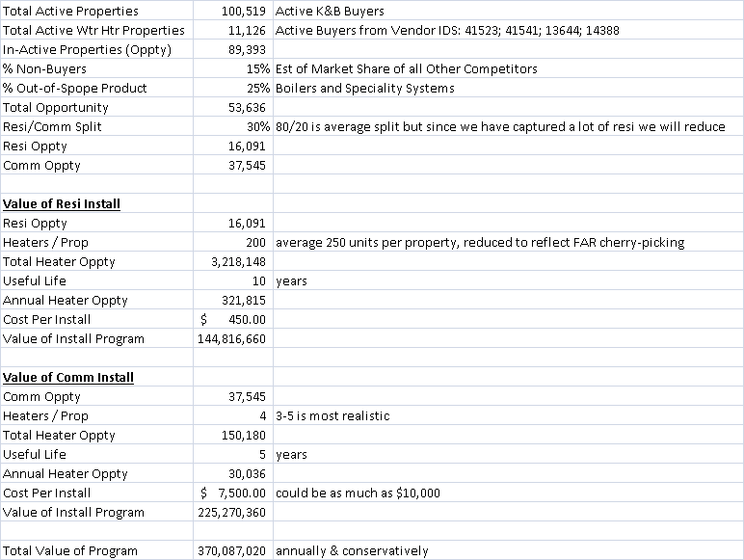
Wtr Htr Install Opportunity

Slide 24
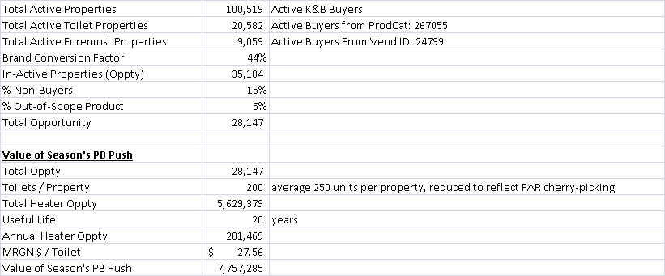
Season’s Toilet Opportunity

Slide 25
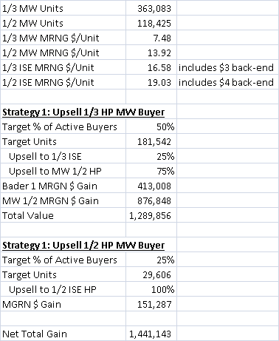
Disposers

Slide 26
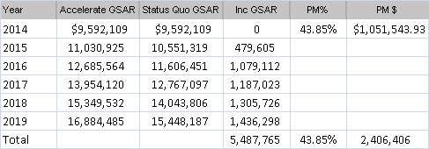
Drain Cleaning

